Slide 1
faculty of Psychology
Presentation to international partners

Slide 2
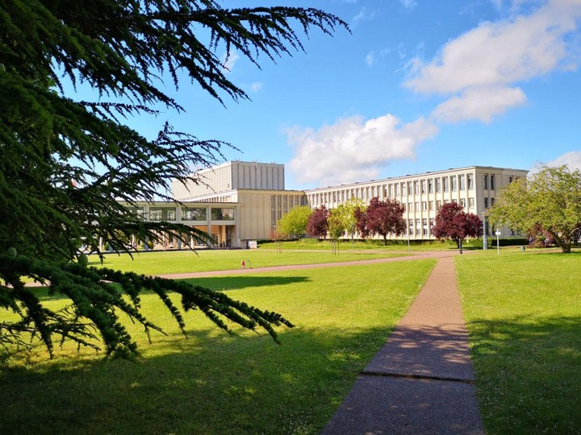
Introduction to international partners
The Normandy region / the city of Caen-La-Mer
The University of Caen: An internationally-oriented institution
The Faculty of Psychology
Course offerings: Bachelor’s, Master’s, PhD, professional training
Teaching methods and innovation
A well-developed working environment
International cooperation:
  Student, teaching and administrative mobility
  Support and success for international students
Research
Useful contacts and links
News

Slide 3


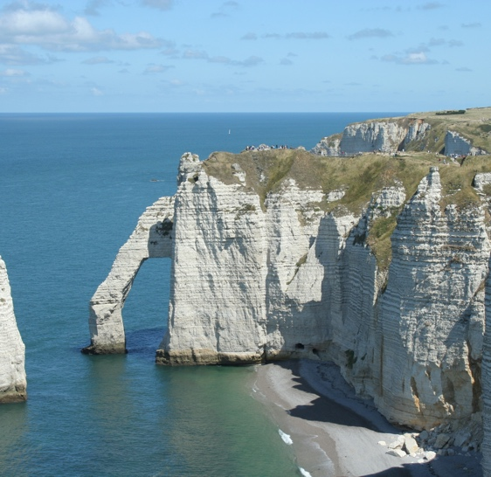

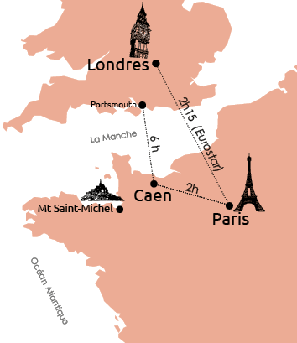
WELCOME TO NORMANDY
MONT SAINT MICHEL
The Normandy region
  Coastal region
  108,000 students
  15 million tourist visits per year
Caen-La-Mer
  20 km from the English Channel
  275,000 inhabitants
  Ranked 1st in Normandy for quality of life
  4th best student city in France by 2026
  Paris 2½ hours away by train, the UK by ferry,
  the South of France by plane
  20% student population
  Europe’s biggest student carnival
ETRETAT
CAEN TOWN HALL

Slide 4
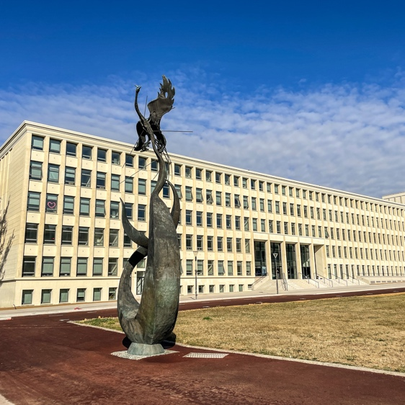
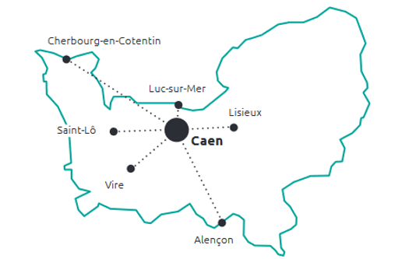
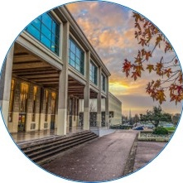
The University of Caen
University founded in 1432 by Henry VI, King of England
Member of AcrossEU’s ‘Seal of Excellence’
5 campuses in Caen & 6 satellite campuses
12 faculties
43 laboratories
International Square
VIDEO PRESENTATION
UNICAEN

Slide 5

The University of Caen
  Over 32,000 students
  95% graduate employment rate
  2,800 staff
  • including 1,700 teaching staff
  +800 PhD students
  • including over 200 international students
  100 postdoctoral researchers
  50 joint supervision arrangements
  international
5 FIELDS OF STUDY
Arts • Humanities • Languages
Law • Economics • Management
Humanities & Social Sciences
Science • Technology •
Health
Physical Education
Physical
and sport
Ψ

Slide 6

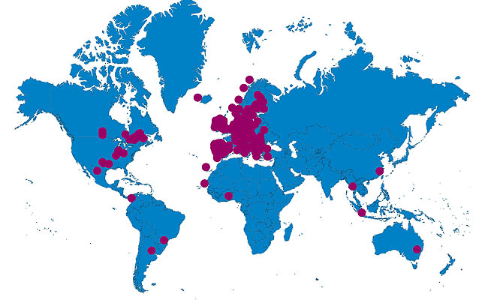





International Students at Unicaen
3,700 international students: 10% of all enrolled students
137 nationalities
+ 400 students studying French as a Foreign Language (FLE)
334 partner institutions in 65 countries
850 exchange places per year
Member of major networks

Slide 7
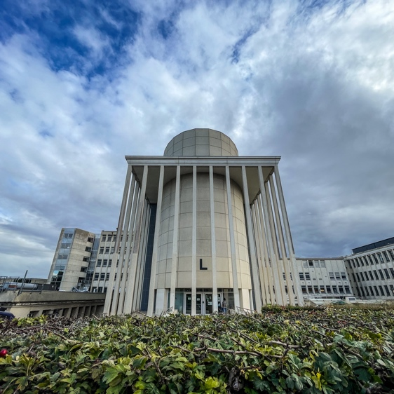
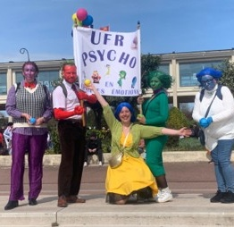
The Faculty of PSYCHOLOGY
(Teaching and Research Unit)
CAMPUS 1
BUILDING L SE
Management Team
  Director: Denis JACQUET
  Deputy Director: Karine LEBRETON
  Administrative Director: Cédric DUPONT
    psychologie.direction@unicaen.fr
  International Liaison Officer: Manuel TOSTAIN
    manuel.tostain@unicaen.fr
STUDENT CARNIVAL

Slide 8

THE FACULTY OF PSYCHOLOGY • At a glance
  1 bachelor’s degree • with a healthcare pathway - 1,014 bachelor’s students
  5 Master’s programmes – 154 Master’s students
  11 administrative and technical staff
6 research laboratories with an international focus
Hosting international Master’s, PhD and post-doc students on research placements
  75 academic staff
  250 guest lecturers
  16 PhD student teaching assistants
  4 temporary teaching and research assistants

Slide 9

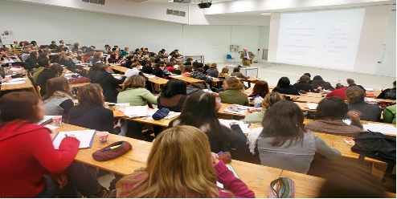
Course offering
A comprehensive initial LMD (3+2+3) degree programme
  Attractive courses:
    First year of the Bachelor’s degree: 4,414 applicants for 500 places
    Master’s Year 1: 4,319 applicants for 85 places
  High pass rates:
    First year: 60%, Second year: 85%, Third year: 80%
    Master’s Year 1: 90%, Master’s Year 2: 97%
PhD
M2
MASTER
M1
Year 3
Bachelor's degree
L2
Year 1

Slide 10

Course offerings
Bachelor’s degree in Psychology (180 ECTS, 60 ECTS per year)
All branches of psychology are taught
  Clinical and pathological
  Cognitive and educational
  Developmental
  Social
  Neuropsychology
  Psychobiology and ethology
LAS OPTION
(Health Sciences Foundation Degree)
Enables students to apply for health-related courses:
Medicine, Pharmacy…
  Career prospects after the bachelor’s degree:
    69% go on to a master’s degree
    11% in employment

Slide 11
Course Offer
Master’s degree in Psychology – 5 specialisations (120 ECTS, 60 ECTS per year)
Clinical Pathway for Child, Adolescent and Family Development
    Skills acquired: assessment and support for children and adolescents
    Career opportunities: organisations in the medical-social and educational sectors
Clinical Neuropsychology Programme for Children and Adults
    Skills acquired: assessment and management of patients with brain injuries
    Career opportunities: hospital sector, care homes, etc.
Specialisation: Educational Psychology
    Skills acquired: prevention, assessment and intervention with children and adolescents with learning difficulties
    Career opportunities: psychologists in the National Education system and specialized institutions
Clinical and Pathological Psychodynamic Psychology pathway
    Skills acquired: Supporting people experiencing psychological distress linked to psychopathologies or traumatic situations
    Career opportunities: psychiatric institutions, victim support organisations, detention centres
Social Psychology and Change Management: Diagnosis and Intervention
    Skills acquired: supporting change at individual and organisational levels
    Career opportunities: auditing, training, human resources, health promotion, eco-citizenship

Slide 12
Course offerings
Master’s degree in Psychology – Career prospects after the Master’s
  Qualifying as a psychologist
Proceeding to doctoral studies
In one of the six laboratories affiliated with the Faculty of Psychology
      85% of graduates in employment
      6 months after completing their Master’s degree
      49 PhD students in 2025
      €1,970 median net salary
      at the start of their career
      80% female PhD students
      10% male PhD students

Slide 13
Training programme
DU in Clinical Neuropsychology
& FC qualification modules
MNPP
BNE1
BNE2
Vocational training
  For lifelong learning
  3 University Diplomas (UD)
  Qualification courses
  15 modules of 20 to 40 hours
  Tailor-made on-site training
TNTA
TSD
AA
TCC1
TCC2
IMAC
MISICO
AA
IPSE Diploma
DU TERV
MND
CBT
METH
CTX
ANX
ADD
PRO
MEM
CEV*
Psychosocial and Environmental Interventions for the Support of People with Alzheimer’s Disease and Related Disorders
Practice of Virtual Reality Exposure Therapy
* Optional module leading to a professional qualification

Slide 14
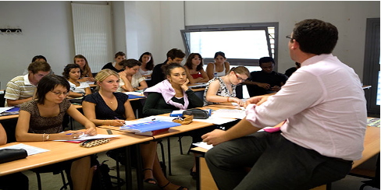
Teaching and innovation
Undergraduate courses:
  Courses in French (required level: B2 for exchange students, C1 for individual students)
  Lectures in lecture theatres and small-group tutorials, online MOOCs, a distance learning platform (eCampus), a variety of teaching methods (collaborative work, flipped classroom, role-play, etc.)
  A variety of assessment methods: written tests, oral exams, computer-based quizzes
  An introduction to research through Study and Research Projects (SRP)
  An optional work placement to explore and gain insight into the psychology profession
  Support schemes to ensure success: tutoring for vocational A-levels and those obtained abroad, tutoring in psychobiology and statistics, remedial support in neuropsychology

Slide 15
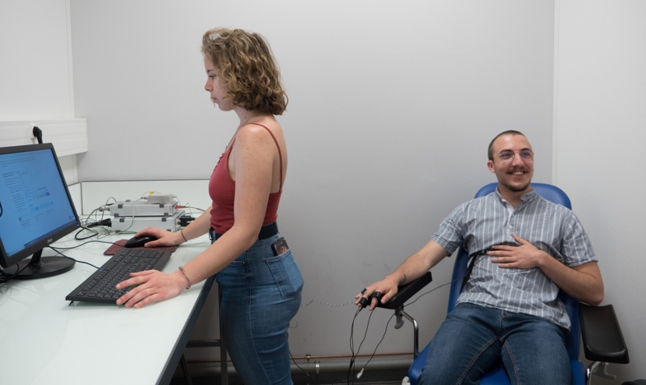
Teaching and innovation
At Master’s level:
  710 hours of teaching and 600 hours of professional placement
  201 lecturers, 80% of whom are professionals (56% psychologists)
  A focus on professional development
  A structured teaching approach based on a skills-based methodology
  Emphasis on practical training for students
  Teaching projects in English and opportunities for placements abroad

Slide 16
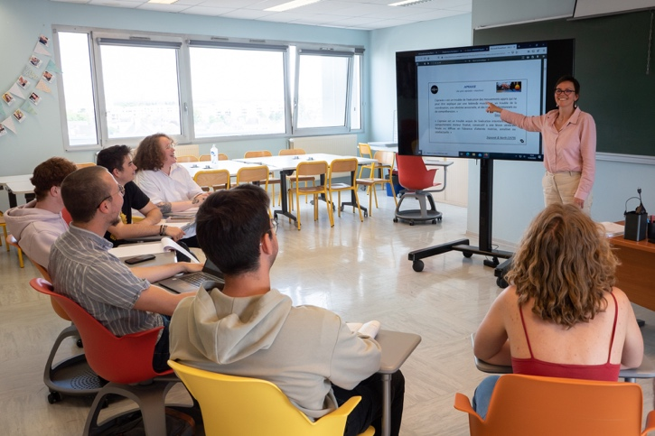
Teaching and innovation
Specialised support services with dedicated
dedicated teaching and administrative staff:
  Recognition of students’ involvement in community activities
  Support for students with disabilities
  Special study arrangements (elite athletes, breadwinners, etc.)
  Equality and anti-discrimination, culture, sustainable development, vocational training

Slide 17

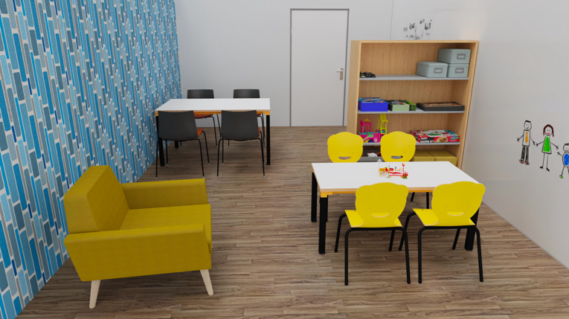


A developed working environment
OPENING OF A UNIVERSITY PSYCHOLOGICAL COUNSELLING CENTRE
‘The Léa VION Center’
1890–1972
Consultation Center
To improve access to care, from consultation to treatment
Training Center
Practical training to
deepen, update or enhance
skills and practices
Research Center
Action research to
develop and validate
clinical tools

Slide 18
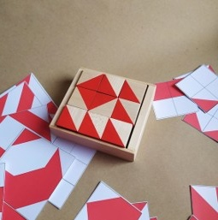

A developed working environment
environment
The Test Library
  Centre for
  Testing
  Psychological
100+ PSYCHOMETRIC TESTS

Slide 19
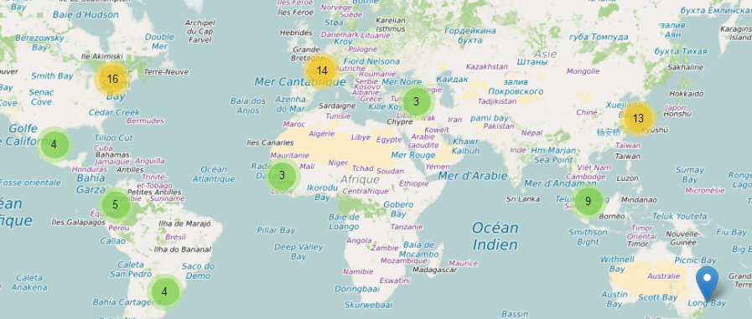
International cooperation
18 Erasmus+ partnerships:
Germany (Halle, Würzburg)
Belgium (Brussels, Leuven)
Spain (Granada, Madrid Computense, La Rioja)
Finland (Joensuu)
Greece (Thessaloniki)
Italy (Bologna, Milan, Urbino)
Poland (Gdańsk)
Romania (Iași)
1 InterU partnership:
United Kingdom (Ormskirk)
Student mobility
Every year:
15 incoming students from every continent
15 to 20 outgoing students with high success rates
Study visits
On a work placement
As an individual applicant
Through an exchange scheme

Slide 20

International cooperation
Support and success for international students
  Two International Advisors
  Manuel Tostain (academic) & Stéphanie Deal (administrative)
  A dedicated international section for incoming and outgoing students
  Tutoring and personalised academic support schemes
  Study guides detailing course content
  An online course selection system called ‘Smile’
    with details of prerequisites for each module
  Academic calendar: Semester 1 (September–December), Semester 2 (January–April)

Slide 21


International cooperation
Teaching and administrative mobility
  Teacher mobility
  hosting and sending teachers for short-term teaching assignments or seminars, ‘visiting lecturers’ scheme
  Administrative mobility
  hosting and sending administrative staff for exchanges of best practice and internationalisation initiatives
3 Erasmus+ partnerships:
  Liège (Belgium)
  Vila Real (Portugal)
  Istanbul (Turkey)

Slide 22



Research
UR 7452 – Caen Normandy Psychology Laboratory (LPCN)
  The LPCN’s research projects fall within two areas of application: health and education
  OPTICOG Programme (optimisation of cognitive abilities in older adults): collaboration with the Centre for Research on Psychological Functioning and Dysfunction (EA 7475) and the GIGA In Vivo Imaging Laboratory at the University of Liège. DREMA Programme (Drunkorexia Research with Ecological Momentary Assessment): collaboration with the Universities of Louvain-la-Neuve (Belgium), Stanford (USA) and Lausanne (Switzerland).
UMRS 1077 – Neuropsychology and Human Memory Imaging (NIMH)
  Unit 1077 is the only research unit in France and one of the few in Europe dedicated solely to the study of human memory and its disorders. UNESCO Chair for Peace: law, history and neurosciences for sustainable peace: collaboration with the Universities of Gaston Berger (Senegal), Saint-Joseph (Lebanon) and Toamasina (Madagascar)

Slide 23


Research
UR 3918 – Centre for Research on Risks and Vulnerabilities (CERREV)
  CERREV’s objective is to analyse, from a multidisciplinary perspective (anthropology, psychology, public health, sociology), individual and/or collective risks and vulnerabilities in contemporary societies, whether Western or otherwise
  UPFRONT Programme (Understanding polarisation and radicalisation to foster political participation, counter extremism, and revitalise democratic debate) with the University of Montreal (Canada); International Consortium for Critical Theories Programme with the Universities of Berkeley and Northwestern (USA); CAPES COFECUB Programme with the Universities of Brasília and Rio de Janeiro (Brazil), etc.
UMR 1237 - Neuropresage
  The unit’s research focuses on the central nervous system and its neurovascular, neuroinflammatory and environmental interfaces. Collaborations with the Universities of Montreal (Canada), Liège (Belgium), Berkeley (USA), Catalonia (Spain), Rabou University (Netherlands), Geneva (Switzerland), etc.

Slide 24


Research
UMR 6552 – Animal and Human Ethology (EthoS)
  This unit’s research focuses on the ethology of a wide range of species, from cephalopods (cuttlefish, octopuses) to human and non-human primates
  Partnerships with the Universities of Montreal (Canada), Tunis (Tunisia), the University of Veterinary Medicine Vienna (Austria), etc.
UMRS 1075 – Mobility: Ageing, Pathology, Health (COMETE)
  Research themes: memory and behavioural plasticity, cognition and mobility, sensorimotor adaptations and remediation through physical activity and chronobiological resynchronisation. Space research programmes in collaboration with NASA (USA), Russia, Japan, Humboldt University of Berlin (Germany)

Slide 25
Contacts and useful links
Website: https://ufr-psychologie.unicaen.fr
Telephone: +33 2 31 56 65 57
Email: scolarite.psychologie@unicaen.fr
Videos: Canal U Caen/psychology
International contacts
Manuel Tostain (academic): manuel.tostain@unicaen.fr
Stéphanie Deal (administrative): stephanie.deal@unicaen.fr
Psychology Students’ Association • EPSYCA
epsyca@gmail.com
Campus 1 • Building N • 1st floor • Rooms SA 111 and 114

Slide 26


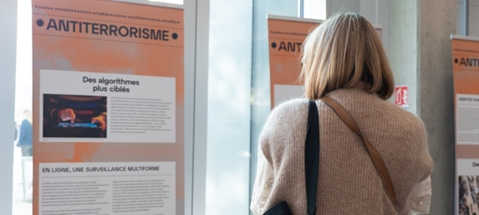

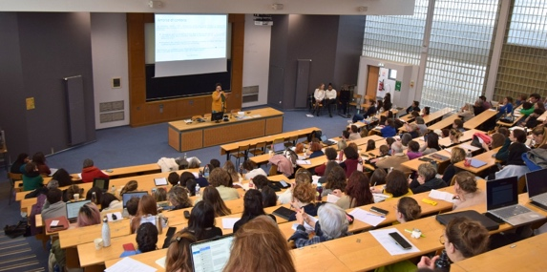
News
Romane, psychologist: changing direction to find your path
The Paris attacks of 13 November 2015: what does science say?
What impact do our thoughts and feelings have on ageing?
How can we break the taboo surrounding incest?

Slide 27
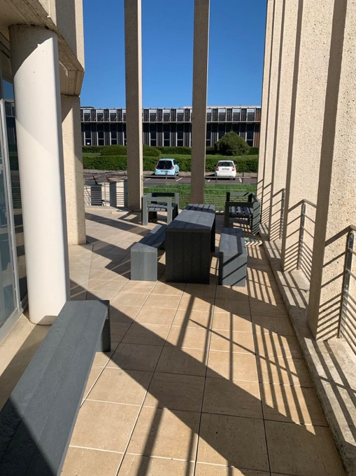
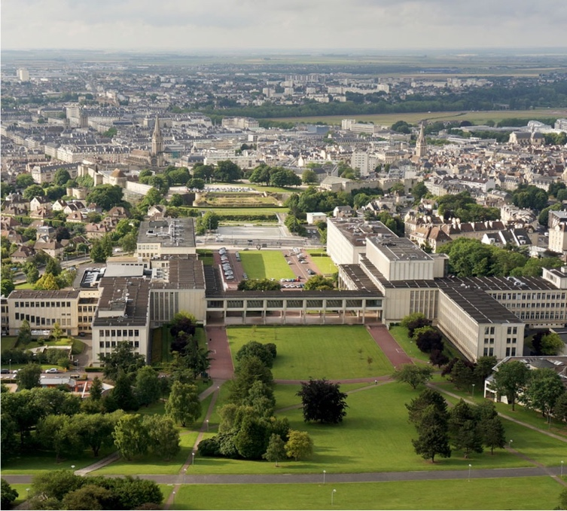

Thank you for your attention
International partners,
international students:
we would like to welcome you to the Faculty of Psychology!
We look forward to answering your questions

